Slide 1

Vivekanand Education Society’s Institute Of Technology
Department Of Information Technology
DSA mini Project
A.Y. 2025-26
Title: DSA Visualizer with GUI Integration
Domain: Data Structures & Algorithms
Member:Priyam Lulla(30)

Slide 2


Slide 3
Content
Introduction to the Project
Problem Statement
Objectives of the Project
Scope of the Project
Requirements of the System (Hardware, Software)
ER Diagram of the Proposed System
Data Structure & Concepts Used
Algorithm Explanation
Time and Space Complexity
Front End
Implementation
Gantt Chart
13. Test Cases
14.Challenges and Solutions
15. Future Scope
16. Code
17. Output Screenshots
18. Conclusion
19. References (in IEEE Format)

Slide 4
Introduction to Project
r Rates
A mini-project to visualize core Data Structures (Stack, Queue, Linked Lists, BST).
Implemented in C language for backend logic.
GUI wrapper in Python (Tkinter) to interact inside a window (no console needed).
Helps students understand working of DSA step-by-step with visual outputs.

Slide 5
Problem Statement
Traditional DSA learning is often abstract and difficult to visualize.
Students struggle to understand stack/queue operations and tree traversal.
Need for a simple, cross-platform tool without complex setup.
Aim: Provide an easy-to-use simulator for DSA concepts.
r Rates

Slide 6
Objectives of the project
Build an interactive mini-project to demonstrate DSA concepts.
Support multiple data structures:
Stack (Array)
Queue (Circular)
Singly, Circular, Doubly Linked List
Binary Search Tree (BST)
Provide ASCII visualization of structures.
Enable Python GUI for seamless usage.

Slide 7
Requirements of the system (Hardware, software)
Hardware:
Windows PC with MinGW (GCC)
4 GB RAM minimum
Software:
C Compiler (MinGW64 / GCC)
Python 3.x with Tkinter
Any IDE (Dev-C++, VS Code, PyCharm optional)

Slide 8
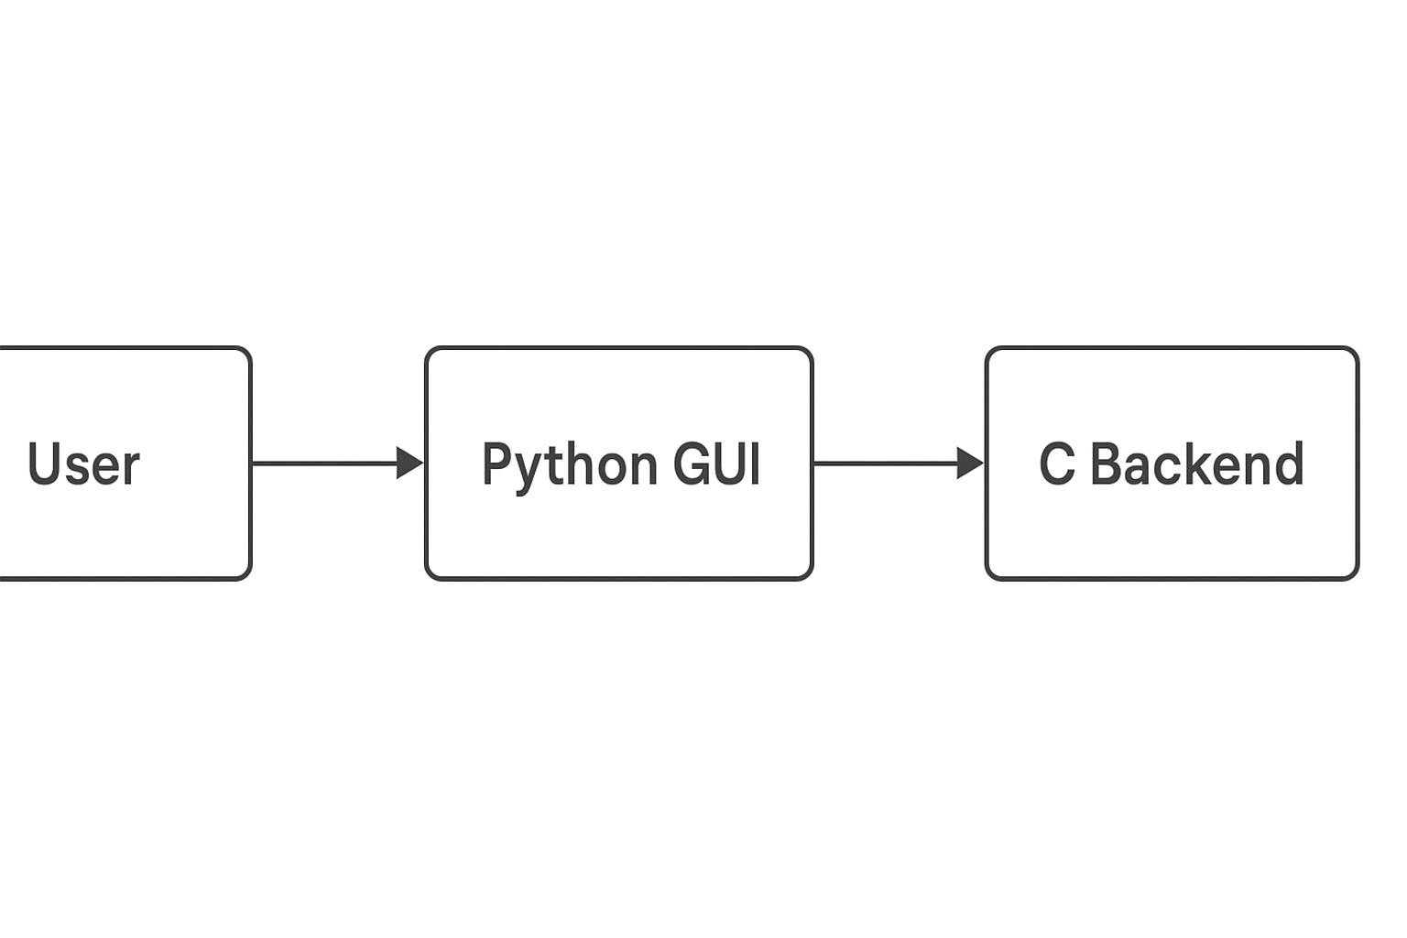
ER diagram of the proposed system

Slide 9
Front End
Python Tkinter GUI
Features:
Text area for output (DSA visualization)
Input box for user values
Buttons for Start/Exit
No external libraries needed

Slide 10
Implementation
Backend: C (MinGW compiled exe)
GUI: Python Tkinter
Communication: subprocess (stdin/stdout)
Visualization: ASCII art inside GUI

Slide 11
Gantt Chart
Week 1: Research & setup
Week 1: Stack/Queue implementation
Week 1: Linked List implementation
Week 1: BST + GUI integration
Week 1: Testing & documentation
Notes:
The max flow algorithm in the visualization is :-

Slide 12
Conclusion
Successfully implemented DSA Visualizer.
Combines C logic with Python GUI.
Helps students understand DSA practically.
Extensible for advanced algorithms.

Slide 13
References
[1] “Introduction to Algorithms”, Cormen et al.
[2] Python.org – Tkinter Documentation
[3] GeeksforGeeks – DSA Tutorials
[4] GCC Documentation

